Slide 1





applied data science
KOKILA.P
VVCET

Slide 2






T A B L E O F C O N T E N T
1 . P R O B L E M S T A T M E N T ,
2 . D E S I G N T H I N K I N G
P R O C E S S ,
. P H A S E O F D E V E L O P M E N T ,
. D A T A
S E T ,
5 . D A T A P R E P R O C E S S I N G
S T E P S ,
T E C H N I Q U E S ,
6 . F E A T U R E
E X T R A T I O N
7 . M O D E L T R A I N I N G ,
8 . E V A L U A T I O N
M E T R I C S ,
9 . C O N C L U C T I O N

Slide 3




PROBLEM STATMENT
The problem is to build a predictive model that forecasts stock prices based on historical market data. The goal is to create a tool that assists investors in making well-informed decisions and optimizing their investment strategies. This project involves data collection, data preprocessing, feature engineering, model selection, training, and evaluation.

Slide 4



DESIGN THINKING PROCESS
Data Collection:
Gather historical stock market data from reliable sources.
Data Preprocessing:
Clean and prepare the data. Handle missing values, outliers, and ensure data consistency.
Feature Engineering:
Create relevant features from the raw data. This could involve calculating technical.
Model Selection:
Choose appropriate machine learning or deep learning models for prediction.

Slide 5


PHASE OF DEVELOPMENT
1.)Problem Definition and Objective Setting:
Clearly define the scope and objectives of your stock price prediction model.Are you interested in short-term or long-term predictions? Whstocks or markets are you targeting? What metrics will you use to evaluate the model's performance (e.g., RMSE, MAE, or Sharpe ratio for investment strategies
2.)Data Collection:
Collect historical market data for the stocks or assets you want to predict. This data typically includes daily or intraday stock prices, trading volumes, and any other relevant financial or economic indicators.
3.)Data Preprocessing:
Clean the data by addressing missing values, outliers, and data discrepancies. This phase might also include data normalization and dealing with irregularities in the time series data.
4.)Feature Engineering:
Create relevant features that can help the model learn patterns and trends in the stock data. Features can include technical indicators (e.g., moving averages, MACD), fundamental data (e.g., earnings, P/E ratios), and sentiment analysis from news or social media.

Slide 6

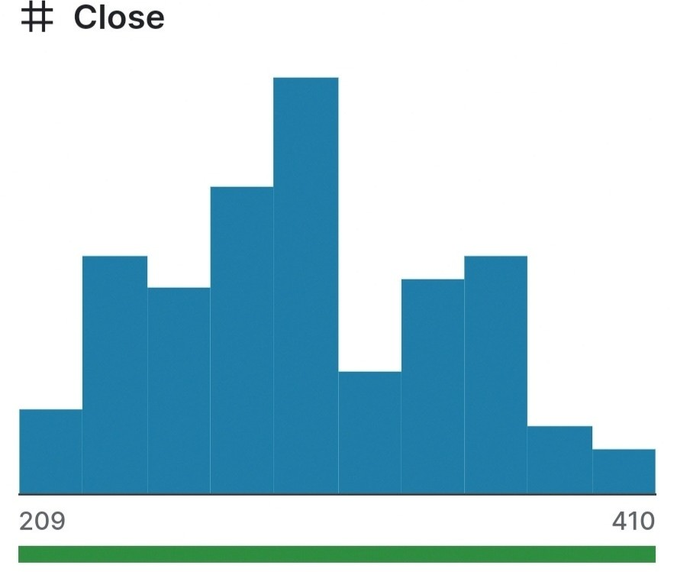
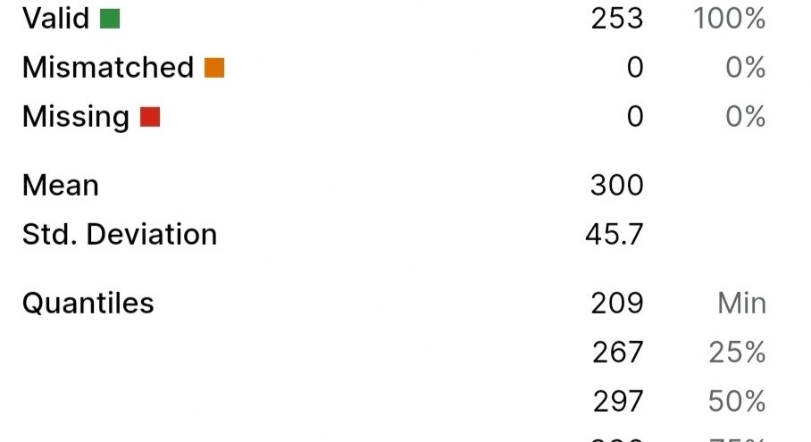

data set

Slide 7

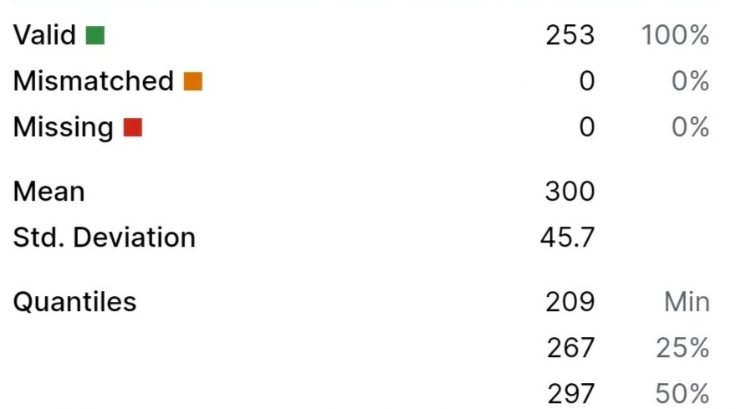
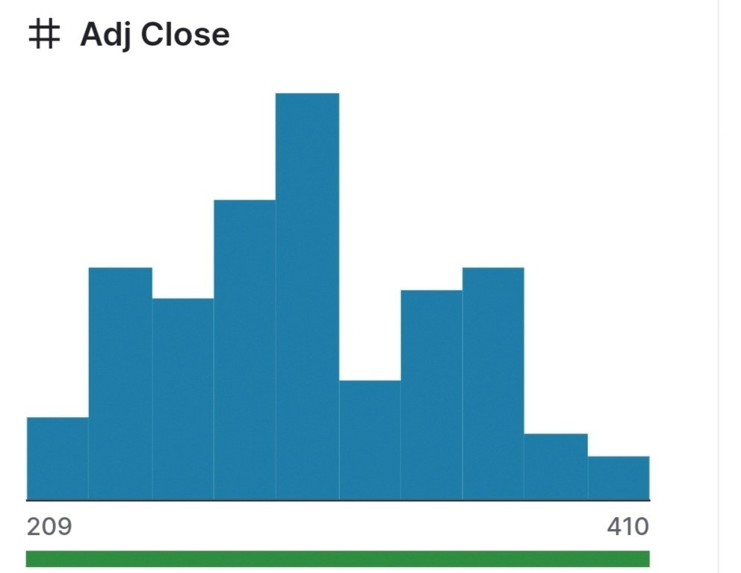



Slide 8
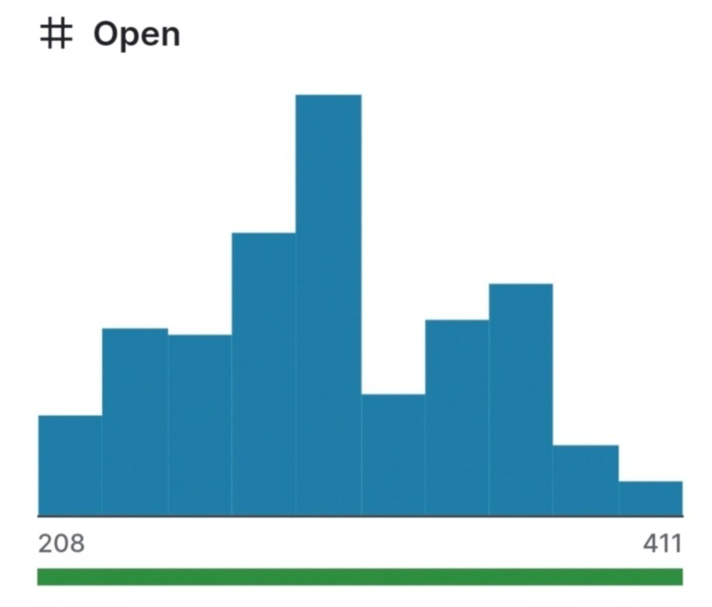
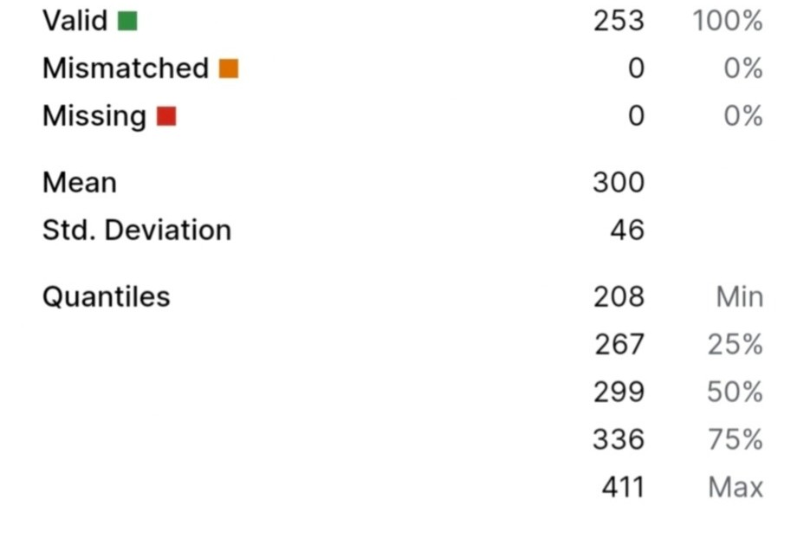

Slide 9

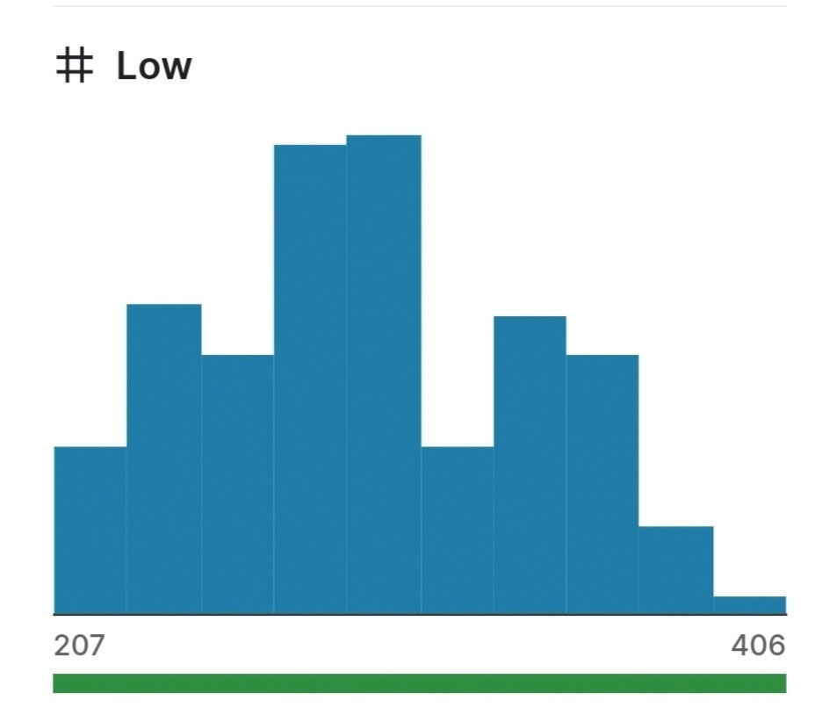
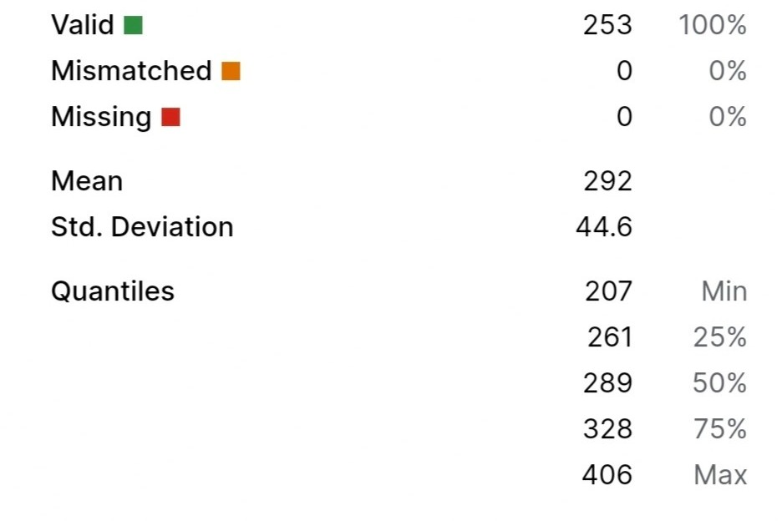


Slide 10
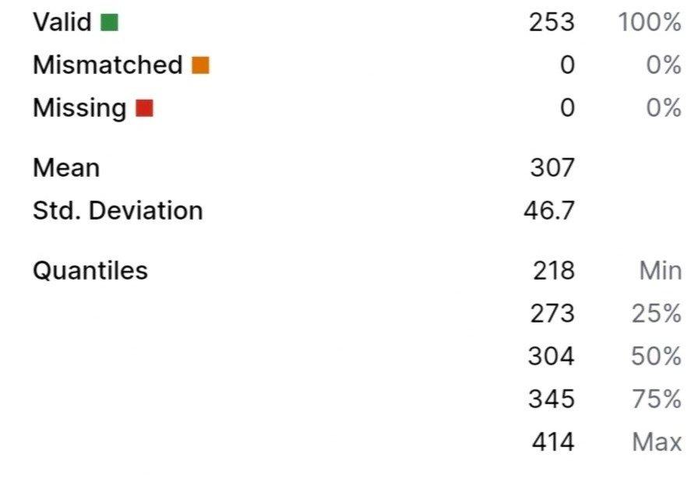
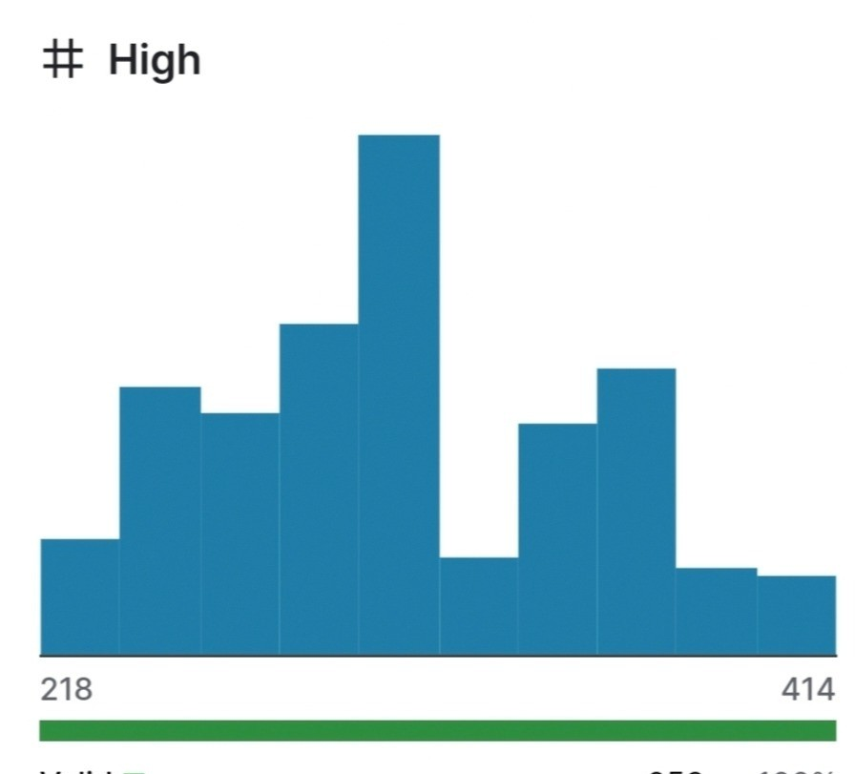


Slide 11
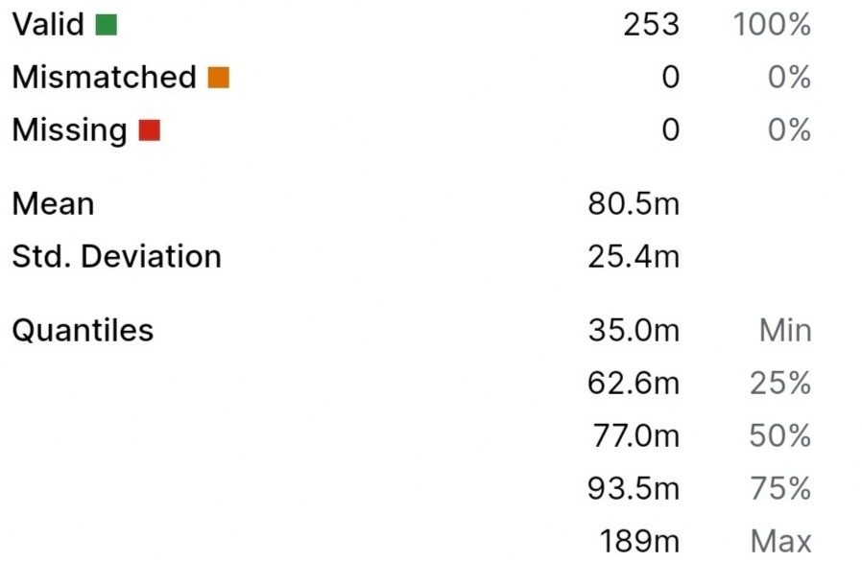
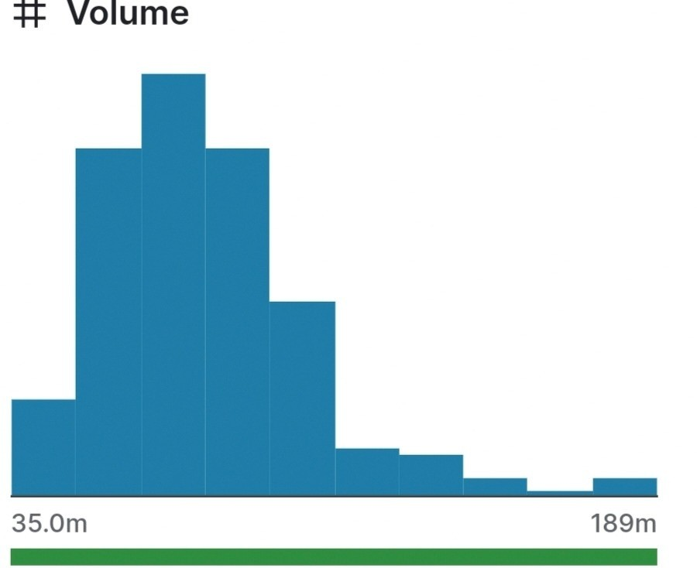

Slide 12
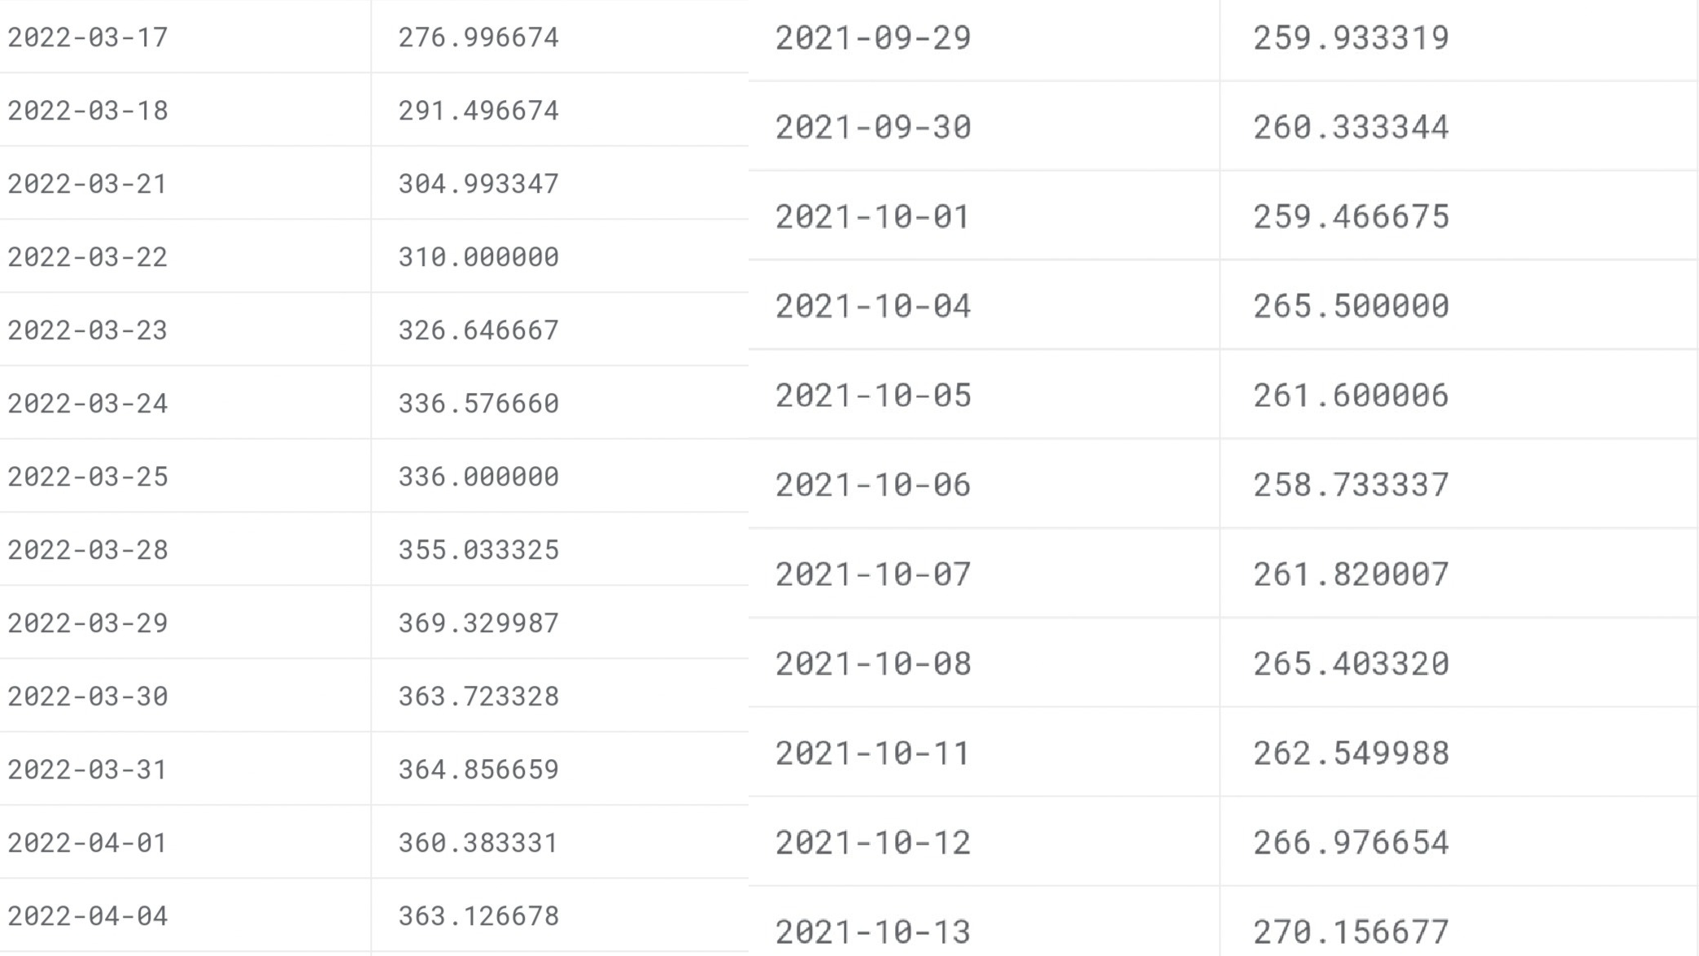


Slide 13
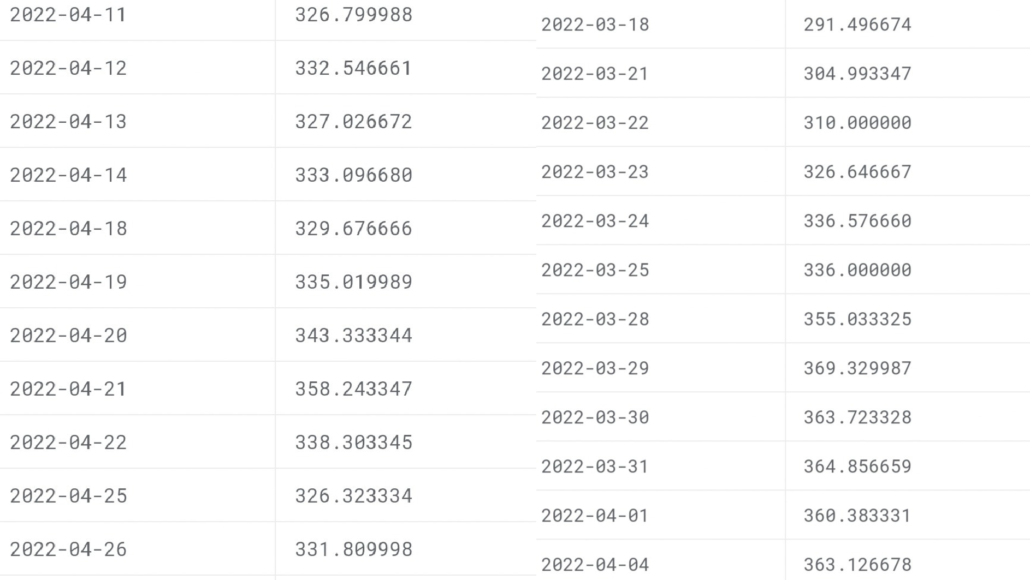

Slide 14
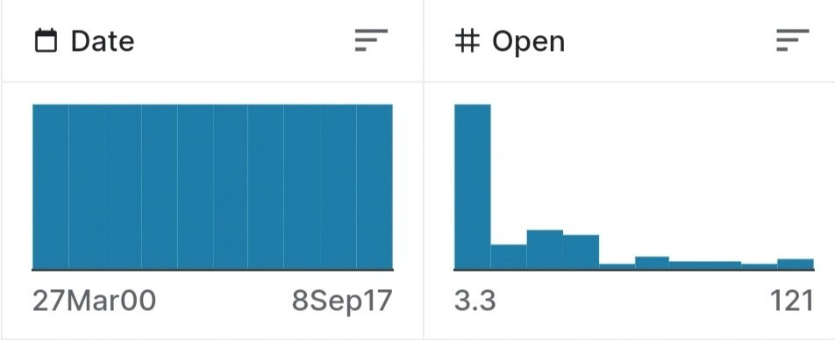

Slide 15
DATA PREPROCESSING STEPS
Data Cleaning:
Handle missing values: Identify and fill in missing data points or remove incomplete records.
Data Normalization/Scaling:
Normalize or scale the data to ensure that different features are on a similar scale. Common techniques include Min-Max scaling or Z-score standardization.
Feature Selection:
Select the most relevant features for your model. This might involve removing redundant or irrelevant features to reduce dimensionality.
Handling Time Series Data:
Address irregular time intervals: If the data has irregular time intervals, you may need to resample it to a consistent frequency.

Slide 16
FEATURE EXTRATION TECHNIQUES
Wavelet Transform Features:
Wavelet transforms can help identify patterns at different time scales in time series data.
Principal Component Analysis (PCA):
Use PCA to reduce dimensionality and capture the most important features in a dataset.
Time-Domain and Frequency-Domain Features:
Analyze the time-domain features (e.g., mean, variance) and frequency- domain features (e.g., spectral entropy) of stock price data.
Market Breadth Indicators:
Create features that reflect the breadth of the market, such as the number of advancing and declining stocks in an index.
Autoencoder-Generated Features:
Train an autoencoder to create compressed representations of the data, which can serve as features.

Slide 17
MODAEL TRAINING
Validation:
Monitor the model's performance on the validation dataset during training. This helps you detect overfitting and assess how well the model is generalizing to unseen data.
Loss Function:
Define an appropriate loss function that quantifies the model's error in predicting stock prices. The choice of loss function depends on the specific task and model.
Regularization:
Apply regularization techniques (e.g., L1 or L2 regularization) to prevent overfitting, particularly for machine learning and deep learning models.
Early Stopping:
Implement early stopping based on the model's performance on the validation set to prevent overfitting and optimize training time.
Model Evaluation:
Evaluate the model's performance on the test dataset using appropriate metrics (e.g., Mean Absolute Error, Mean Squared Error, or financial metrics like Sharpe ratio, if applicable).

Slide 18
EVALUATION METRICS
Mean Absolute Error (MAE):
MAE measures the average absolute difference between predicted and actual stock prices. It provides a simple and interpretable measure of the model's accuracy.
Formula: MAE = (1/n) * Σ|actual - predicted|
Mean Squared Error (MSE):
MSE measures the average squared difference between predicted and actual stock prices. It penalizes larger errors more heavily.
Formula: MSE = (1/n) * Σ(actual - predicted)^2
Root Mean Squared Error (RMSE):
RMSE is the square root of the MSE and provides an interpretable measure of the typical prediction error. It is in the same unit as the target variable.
Formula: RMSE = √(MSE)
Percentage Error Metrics:
Relative metrics like Mean Absolute Percentage Error (MAPE) and Mean Percentage Error (MPE) can provide insights into the model's predictive accuracy in percentage terms.
Formula (MAPE): MAPE = (1/n) * Σ(|(actual - predicted) / actual|) * 100

Slide 19
CONCLUSTION
IT'S IMPORTANT TO CHOOSE EVALUATION METRICS THAT ARE RELEVANT TO YOUR PARTICULAR USE CASE AND TO CONSIDER THE TRADE-OFFS BETWEEN VARIOUS METRICS. ADDITIONALLY, IT'S COMMON TO USE A COMBINATION OF THESE METRICS TO GET A COMPREHENSIVE UNDERSTANDING OF YOUR MODEL'S PERFORMANCE. REMEMBER THAT THE CHOICE OF EVALUATION METRIC SHOULD ALIGN WITH THE SPECIFIC GOALS AND CONSTRAINTS OF YOUR STOCK PRICE PREDICTION PROJECT.

Slide 20
T H A N K Y O U

